Slide 1


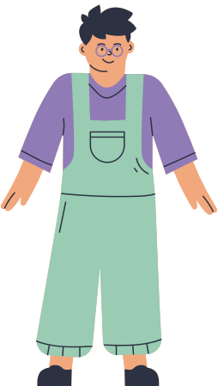

LEARNING ENGLISH
“A Journey of Language Mastery”
Presentation by Manal Baig

Slide 2
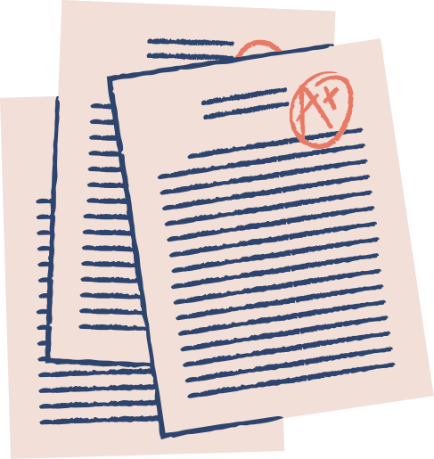





The Importance of English
Language Skills Overview
Developing Listening Skills
Improving Speaking Skills
English for Classroom
Conclusion
LIST OF CONTENTS

Slide 3




The Importance of English
English has an important role in the global context and provides various benefits. Some reasons why English is important to learn include:
Global Communication
Adaptability
Technological Advancement
English is an international language used in many fields, including business, technology, and diplomacy.
By mastering English, a person can more easily adapt to global situations, whether traveling, working or studying abroad.
English dominates the digital and technological world. Many online resources, tutorials and technology documentation are in English.

Slide 4




LANGUAGE SKILLS OVERVIEW
Listening
Speaking
There are 4 key elements that need to be mastered during the journey of learning English.
Reading
Writing

Slide 5




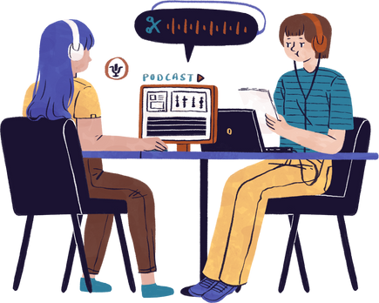
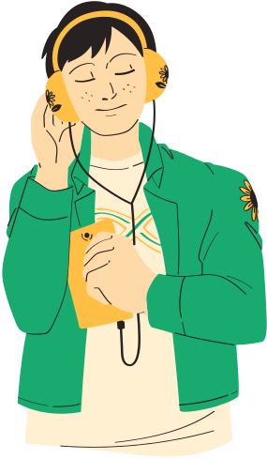
DEVELOPING LISTENING SKILLS
Developing listening skills can be done in several ways, including:
Listen to
English podcasts
Using Audiobooks
Language Apps with an Audio Focus

Slide 6





Improving Speaking Skills
Ways to improve speaking skills in English can be done through the following things:
Join a Speaking Club
Do Conversation Practice
Take Part in a Language Exchange

Slide 7


MASTERING READING AND WRITING
How to master reading and writing skills in learning English can be done with the following things:
Reading Various Materials
Writing Practice
Read various materials, including books, articles and news, to enrich understanding and vocabulary.
Do writing exercises, such as daily journaling or short essays, to improve your writing skills.

Slide 8


CONCLUSION
In closing, let us continue to welcome this journey with an undying enthusiasm for learning. English is not just a skill, it is a wide open window to a world of knowledge and opportunity.

Slide 9


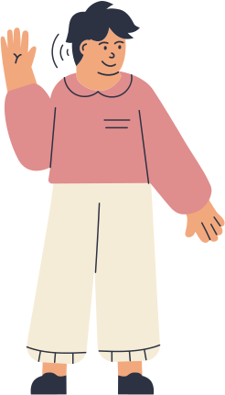
DO YOU HAVE ANY QUESTIONS?

Slide 10
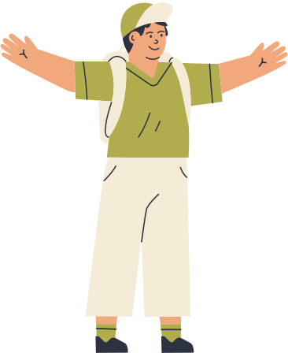
THANK YOU!

